Slide 1
Project dashboard
ADVANCED OBJECT ORIENTED PROGRAMMING
UNDER THE GUIDANCE OF
Dr. ANURADHA NANDULA
REVIEW 1

Slide 2

PROBLEM STATEMENT:
Designing a java based android application which allows to send messages from one user to other user .
We provided a login account process so that once use is set , the data for that user will be stored in that account.

Slide 3
New feature:
A PROJECT DASHBOARD is added where the admin of a group consisting a number of other groups related to topic , can see the dashboard details updated by the people consisting in the groups.

Slide 4
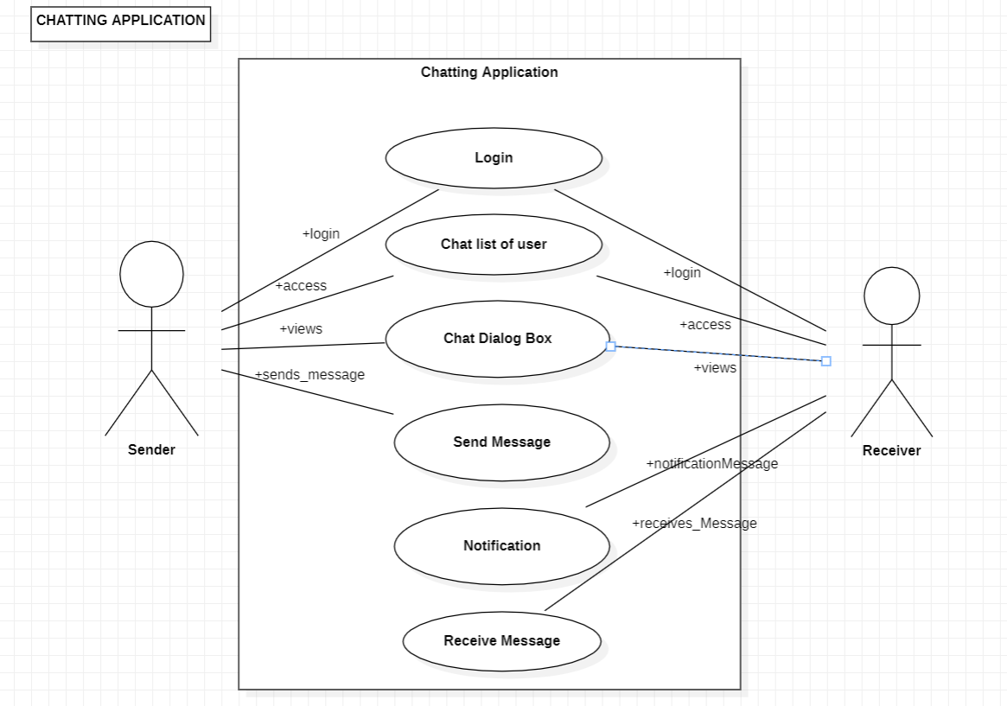
Use-case diagram:

Slide 5
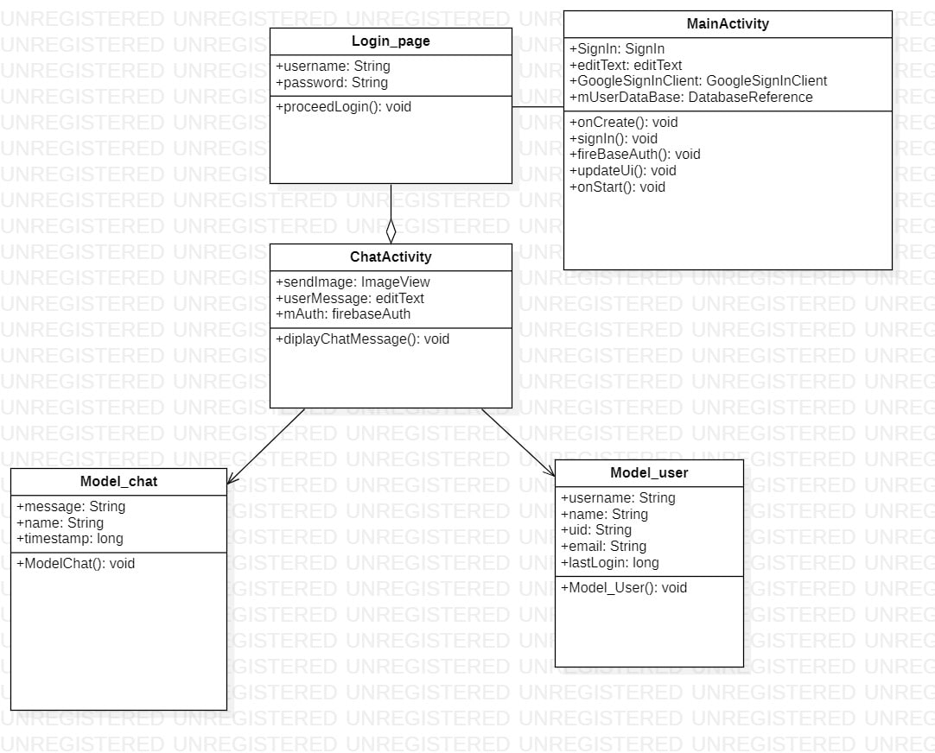
Class diagram:

Slide 6
TEAM MEMBERS
2110030209 – ALLU JYOTHI SWAROOP (Project content)
2110030217 – G. SRI VARDHAN REDDY (Use Case Diagram)
2110030256 – R. SATYA SAI (Class diagram)
2110030307 – CH. DILEEP REDDY (Problem Statement)

Slide 7


